Slide 1
Mykhail Galushko co-founder DevRain Solutions Microsoft MVP
Creating high rated and reliable Windows 8 application

Slide 2
1. Why bad rating?
2. Problem areas in WinStore apps 3. Windows Store tools
4. Windows 8.1 features
5. Third-party logging services
Application

Slide 3
Reasons of bad rating
Application

Slide 4
10 problem areas in Windows Store app
Suspend/Resume
Terminate/Restart
App version updates
Network connectivity
Asynchronous operations
Application

Slide 5
10 problem areas in Windows Store app
6) Resolutions and orientations
7) Device testing
8) Localizability
9) Accessibility
10) User experience guidelines
Application

Slide 6
Suspend/Resume – Terminate/Restart
Activated
Suspending
Running
Application
Not Running
Resuming
Suspended
Terminating

Slide 7

Suspend/Resume – Terminate/Restart
Validate app state on resume: user sessions, sensors state, service connections
Use VS tools to simulate events:
Application

Slide 8
App version updates
Test every app update before release
Make data storage migrations if needed
If using API – check min server version to communicate
Application

Slide 9
Network connectivity
Test no connection
Test slow connection (with Fiddler)
Do not use NetworkInformation.GetInternetConnectionProfile(): can be null when using mobile internet
Application

Slide 10
Asynchronous operations
Check async operations:
several starts problem – block UI after start
invalid call order
think twice about “async void” methods
add delays for testing
Application

Slide 11
Resolutions and orientations
Use simulator to check all resolutions
Check from 1024x768 to …
Check Snapped / Filled views
Windows 8.1: + 500px width size
Check popups & settings pane for small resolutions
Application

Slide 12
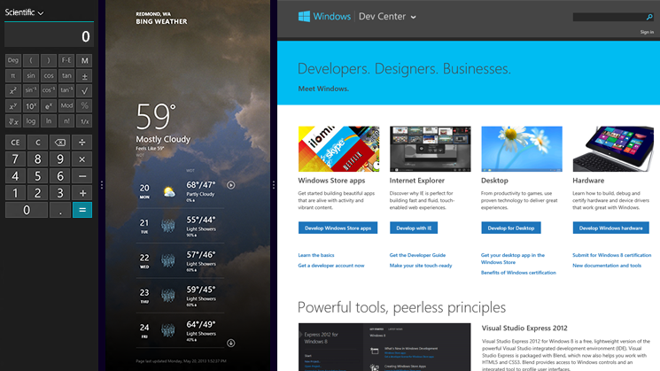
Application

Slide 13
Device testing
x86
x64
ARM
Especially for C++
Application

Slide 14
Localizability
Use Multilingual App Toolkit to generate pseudo translations
Application

Slide 15
Accessibility
Visual: high/contrast, text contrast
Keyboard accessibility: onscreen and physical
Application

Slide 16
User experience guidelines
App bars
Flyouts (popups)
Navigation
Layout
Animation
Application

Slide 17
Windows Store features
JavaScript exception rate
Crash rate
App unresponsive rate
Error reports
Application

Slide 18
Windows 8.1 features – Logging API
Application
Storage file
Logging Channel
Logging Channel
Logging Session
My backend service
Logging Channel

Slide 19
Windows 8.1 features – Logging API
var channel = new LoggingChannel (“MyChannel");
channel.LoggingEnabled += (sender, args) => {
_isLoggingEnabled = sender.Enabled;
_channelLoggingLevel = sender.Level; }
var level = LoggingLevel.Error;
if (_isLoggingEnabled && level >= _channelLoggingLevel) {
channel.LogMessage(“message", level);
channel.LogValuePair(“custom parameter", 42, level); }
Application
Storage file
Logging Channel
Logging Session
My backend service

Slide 20
Windows 8.1 features – Logging API
var session = new LoggingSession(“MySession");
session.AddLoggingChannel(channel, LoggingLevel.Warning);
//on error
StorageFile logFile = await session.SaveToFileAsync(logFolder, name)
//upload in background to my backend service
Application
Storage file
Logging Channel
Logging Session
My backend service

Slide 21
Windows 8.1 features – Logging API
var session = new FileLoggingSession(“MySession");
session.AddLoggingChannel(channel, LoggingLevel.Warning);
session.LogFileGenerated += (senders, args) => {
await args.File.MoveAsync(logFolder);
//upload in background to my backend service
}
var file = await session.CloseAndSaveToFileAsync();
Application
Storage file
Logging Channel
Logging Session
My backend service

Slide 22
Third-party logging services
Bugsense
Limited Free
User analytics
WinJS support
Integration: JIRA, Pivotal Tracker, Github, Hipchat
http://www.bugsense.com
Application

Slide 23
Third-party logging services
Localytics
User analytics
Error logging as events
WinJS support
Full free plan
http://www.localytics.com
Application

Slide 24
Third-party logging services
MarkedUp
User analytics
WinJS support
Full free plan
http://www.markedup.com
Application

Slide 25
Third-party logging services
Wensus
User analytics
Free plan for 1 app
Paid plan: + reviews + performance reports
http://www.wensus.com
Application

Slide 26
Q&A

